Slide 1
Cisco Training by ICC
Session 4 :
VLAN Overview

Slide 2
What is VLAN ?

Slide 3
It’s Grouping of devices on different Subnets .
Each VLAN has a subnet.

Slide 4
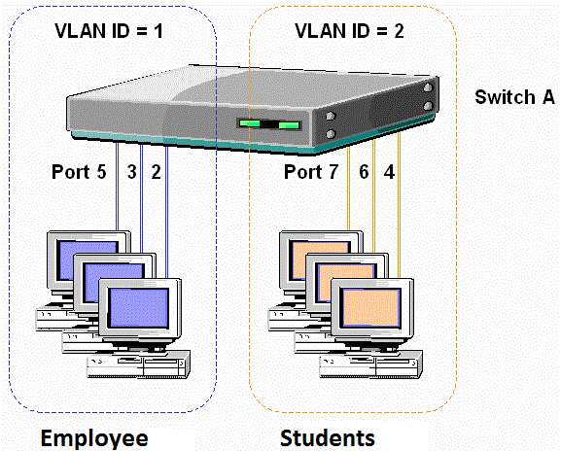
VLAN is a port based Configuration

Slide 5
What are the advantages of using VLANS ?

Slide 6
Increased performance
Improved manageability
Physical independence
Increased Security Option

Slide 7
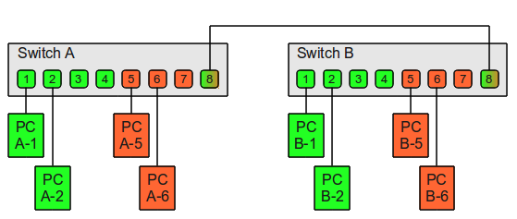
Multi Switches

Slide 8
A Switch Port could be configured in two mode :
1- Access Port
2- Trunk Port

Slide 9
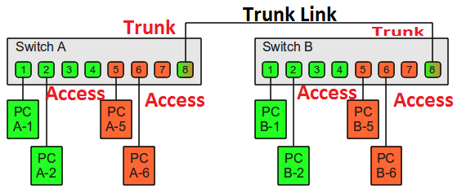

Slide 10
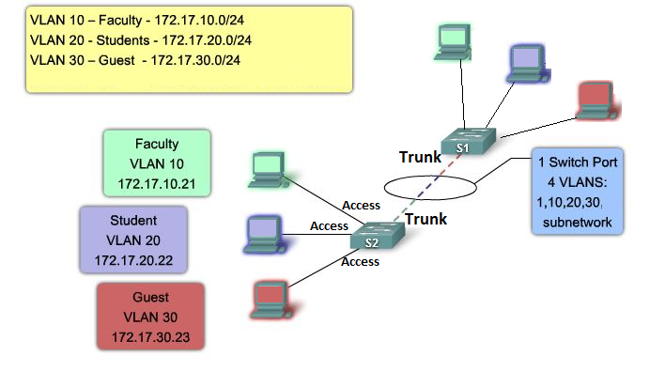

Slide 11
VLAN Configuration
1-Define A VLAN
2- Configure Port in access mode
3- Configure Port in Trunk mode

Slide 12
1-Define VLAN’s
Switch(config)# vlan 10
Switch(config-vlan)# name Internet
Switch(config)# vlan 20
Switch(config-vlan)# name Intranet
Switch(config)# vlan 30
Switch(config-vlan)# name Voice

Slide 13
2- Configure Port in access mode
A-configure port 1 to be in vlan 10
Switch(config)# int fa0/1
Switch(config-if)# switchport mode access
Switch(config-if)# switchport access vlan 10
B-confiure port 5 to be in vlan 20
Switch(config)# int fa0/5
Switch(config-if)# switchport mode access
Switch(config-if)# switchport access vlan 20

Slide 14
3- Configure Port in Trunk mode
configure port 10 in trunk mode
Switch(config)# int fa0/10
Switch(config-if)# switchport mode trunk

Slide 15
Configure Multi Ports
A-configure port 1 to 9 to be in vlan 10
Switch(config)# int range fa0/1-9
Switch(config-if)# switchport mode access
Switch(config-if)# switchport access vlan 10
B-confiure port 11,15 to be in vlan 20
Switch(config)# int range fa0/11 , fa0/15
Switch(config-if)# switchport mode access
Switch(config-if)# switchport access vlan 20

Slide 16
Verification Commands
Show vlan
Show interface trunk
Show interface status
Show run
Show run interface gi1/0/1

Slide 17
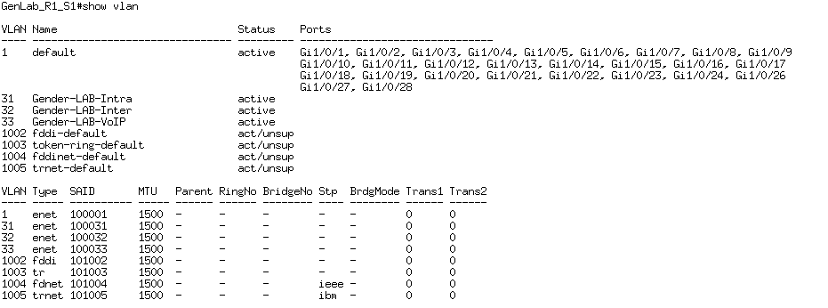
Show vlan

Slide 18
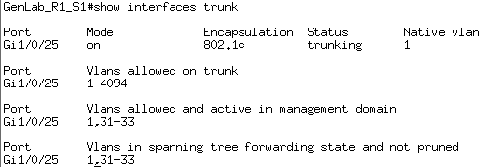
Show interface trunk

Slide 19
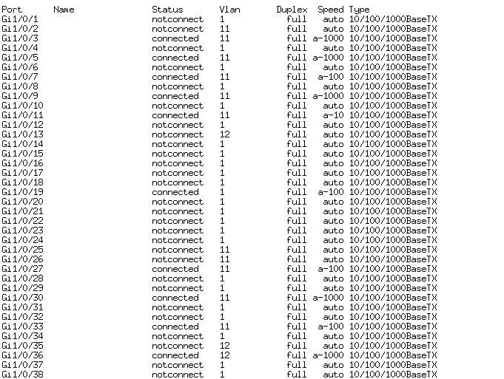
Show interface status

Slide 20
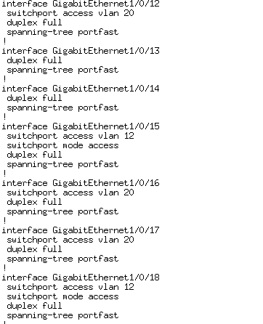
Show run

Slide 21
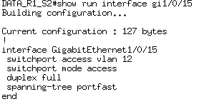
Show run interface gi1/0/15

Slide 22
End …

